Slide 1


SRM INSTITUTE OF SCIENCE AND TECHNOLOGY
DEPARTMENT OF CSE
IOT BASED AUTOMATIC WASTE MANAGEMENT SYSTEM
By
SIDDHARTH SHUKLA – RA1811003020423
RAHUL RAI– RA1811003020449
Guide
M.S. Sellam Veera
Senior Professor, Department of Computer Science And Engineering

Slide 2
PROBLEM STATEMENT
The key issue in the waste management is that the garbage bin at public places gets overflowed well in advance before the commencement of the next cleaning process.
It in turn leads to various hazards such as bad odor & ugliness to that place which may be the root cause for spread of various diseases.
To avoid all such hazardous scenario and maintain public cleanliness and health this work is mounted on a smart garbage system.

Slide 3
DOMAIN AREA
Internet and its applications have become an integral part of today’s human lifestyle. It has become an essential tool in every aspect. Due to the tremendous demand and necessity, researchers were beyond connecting just computers into the web. These researches led to the birth of a sensational gizmo, Internet of Things (IOT). Communication over the internet has grown from user – user interaction to device – device interaction these days. The IOT concept proposed years back but still it’s the initial stage of the commercial deployment.

Slide 4
ABSTRACT
1. The whole process is up held by an wi-fi module integrated with and IOT Facilitation.
2. The real time status of how waste collection is being done could be monitored and followed up by the municipality authority with the aid of this system.
3. In addition to this the necessary remedial / alternate measures could be adapted.
4. An Web based application is developed and linked to a web server to intimate the alerts from the microcontroller to the urban office and to perform the remote monitoring of the cleaning process, done by the workers, thereby reducing the manual process of monitoring and verification.
5. The notifications are sent to the Web based application using wi-fi module.

Slide 5
Literature survey - Paper 1
Title : IOT Based Automatic Waste Management System
Journal &Year : IEEE & 2013
Concept :We have implemented real time waste management system by using smart dustbins to check the fill level of smart dustbins whether the dustbin are full or not.
Disadvantages : Privacy issues , Inaccuracy , loss of internet connection due to bad weather.

Slide 6
Literature survey - Paper 2
Title : Smart Waste Management System using IOT
Journal & Year: IEEE & 2015
Concept : In this project Ultrasonic sensor will be used to detect the level of garbage filled in the dustbin. The level of garbage will be depicted in terms of distance between the sensor and garbage in dustbin.
Disadvantages : Lack of connection , Signal or battery failure

Slide 7
Literature survey -- Paper 3
Title : Waste Management System using IOT-Based Machine Learning
Journal & Year : IJSDR & 2016
Concept : Considering the advantages of IoT technologies, many researchers have investigated and developed new applications for smart cities, especially for waste management.
Disadvantages : The idea has some ambiguous problem in the system, they only concentrated on the collection of data.

Slide 8
Literature survey - Paper 4
Title : Household Waste Management System Using IOT
Journal & Year : IEEE & 2016
Concept : The concept of smart city could not be fulfilled without the intention of people and society. In this paper, author proposed the waste management system for a green society with advance features such as it automatic open and close the lid when any one reach near the dustbin, detection of poisonous gas.
Disadvantages : Cost required is more, any type of waste can be dumped which is not a good idea.

Slide 9
Literature survey - Paper 5
Title : Efficient IOT Based Smart Bin for Clean Environment
Journal & Year : IJIRCCE & 2019
Concept : Dustbins are containers used for collecting household waste all around the world. In our day to day life, we dispose variety of waste materials categorized as industrial waste, sewage wastes, domestic wastes etc. Dustbins are used for collecting the domestic waste materials. Indoor dustbins are used to collect wastes from household, which are then disposed into the outdoor dustbins maintained by the Corporation or municipality.
Disadvantages : Loss of connection due to bad weather condition, breakdown of sensors due to heavy load.

Slide 10
Proposed system
This Efficient Waste disposal or Management System is considered as an essential for Modern Smart Cities (MSC). Internet of Things (IoT) can be implemented both in IS and MSC creating an highly developed proposal for future Operations. Special methods can be applied to enhance technology used for high Quality of Service (QoS) in our waste management system. Specifically, IoT components like sensors, detectors, and actuators are integrated into Intelligent System (IS) and Inspection systems for efficient waste management. We recommend a sophisticated IS for efficient waste management in Smart Cities. The proposed system is an automated alert based smart bin or garbage collection system and to alert the authorities like corporation or local waste disposal team. Using this, we can monitor the complete waste disposal in an efficient way.

Slide 11
TECHNIQUE USED
The Automatic Waste Segregator System is driven by the Microcontroller
Arduino UNO. All the components that are connected to Arduino UNO are programmed using the Arduino IDE. The program is written in Embedded C language and it reads the input/output pins of the components.
*For Segregation:
Conveyor Belt
DC Motor
Servo Motor
Moisture Sensor
Proximity Sensor
*For Detection Of Waste Level
Ultrasonic Sensor
GSM Module
Arduino IDE

Slide 12
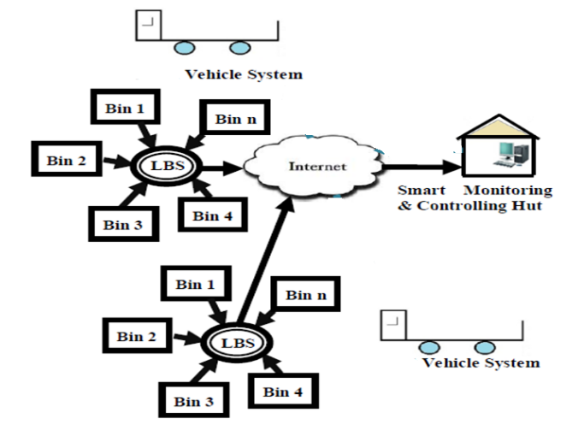
System architecture

Slide 13
MODULES
Data Set Module
Captures data from different sources.
It cleans the data(removal of garbage value)
Feature Selection Module
To shorten the training time of the model
To reduce the dimensionality.
Validation of Model
Validation is the process of checking whether the algorithm is applied to the given dataset or not. Thus the accuracy of the model should be as high as possible.
We can also apply two or more algorithms to check the model and we can select which algorithm is best.
The output values obtained from the model are recorded.

Slide 14
IMPLEMENTATION
Software Used to implement IOT Based Application
Microsoft Visual Studio
SDK
Emulator
Genymotion
The user enters information using application interface.
2. Java Code interacts with the interface and perform http calls to the server side 3. The server side uses PHP language to interact with the database.

Slide 15
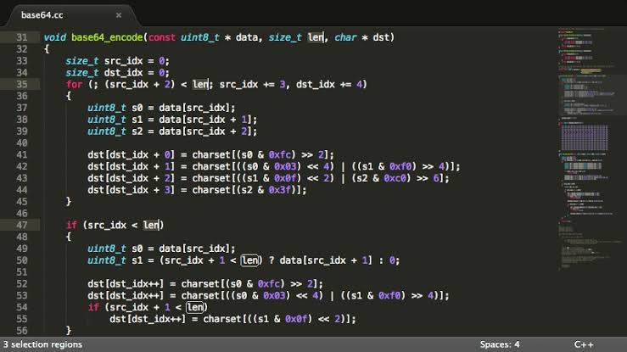
Client side code : Main Functions

Slide 16
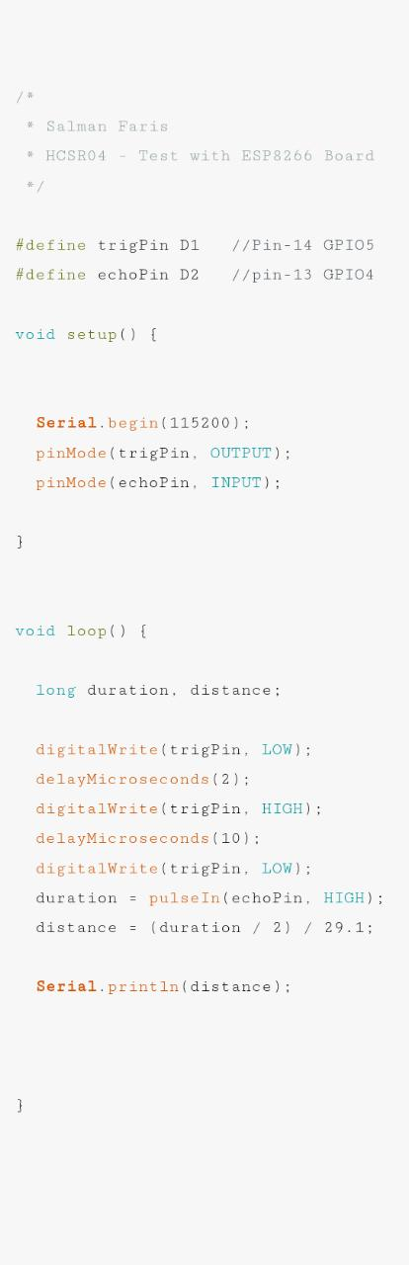
Client Code Server Code

Slide 17
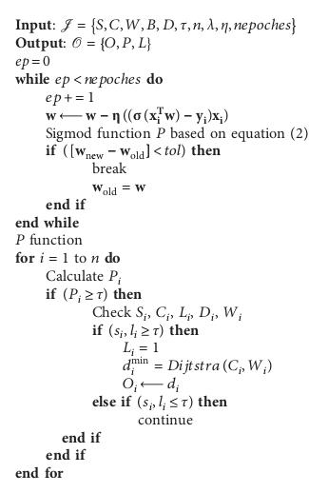
.

Slide 18
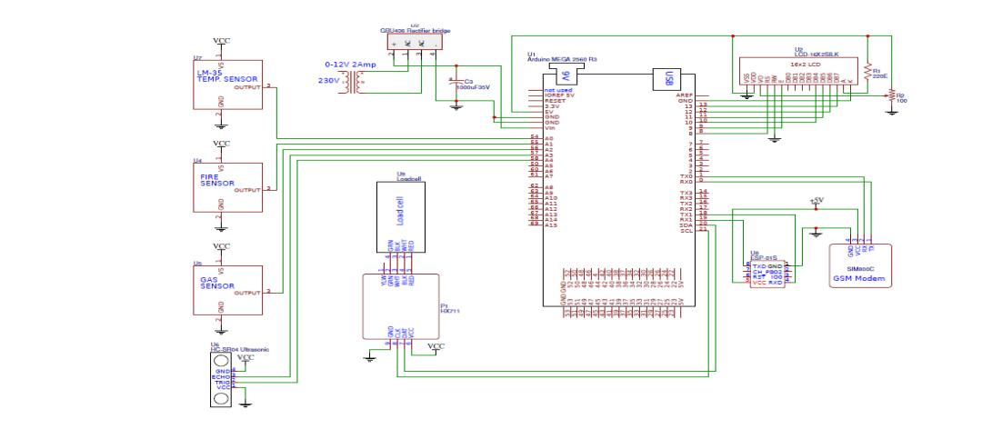
.

Slide 19
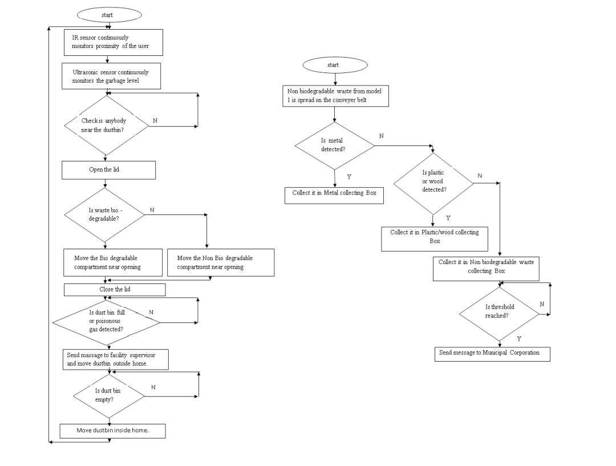

Slide 20
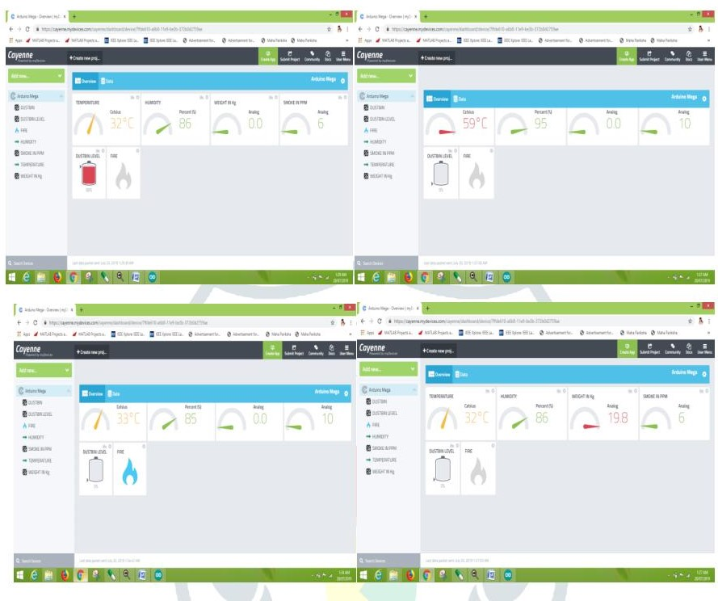
OUTPUT:

Slide 21
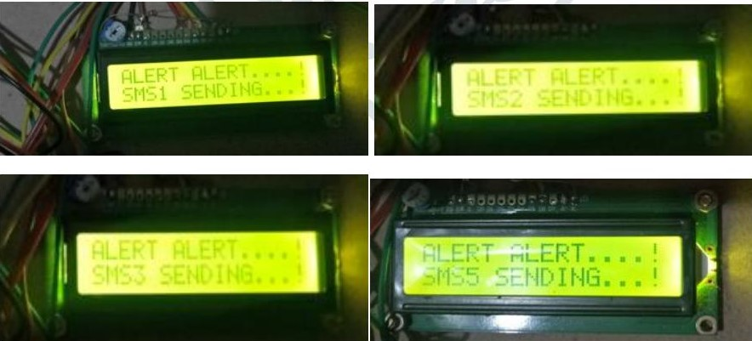

Slide 22
ALGORITHM TECHNIQUE: Algorithm 1: Working of smart dustbin at Level1 1. Initialize flag=1, th level =20 cm, thp level=0.3 2. If ir user< 40mm “open the lid” 3. if b=1 then if flag=1 “No Rotation” Else “180 degree Rotation”

Slide 23
flag=1 endif endif 4. if nb=1 then if flag=1 “180 degree Rotation” flag=0 else “No Rotation” endif endif 5. “close the lid after delay of 30 sec” end if

Slide 24
6. if b level>= th level || nb level>= th level|| pg level>= thp level
“Move the dustbin outside home”
“Send message to the facility supervisor”
endif
7. if b level== 0 || nb level== 0
“Move the dustbin inside home “
endif
8. goto step 2

Slide 25
CONCLUSION
The proposed method for the management of wastes is efficient and time saving process. This automation of waste also reduces the human effort and consequently the cost of the whole process. Thus a hygiene and clean environment can be provided. This project helps in identifying all possible smart garbage management methods that can be implemented to make society clean.
The objective of this research is to make the society as a smart green society which is environmentally sound and healthy. This model continuously monitors the level of waste in the biodegradable and non biodegradable compartment of the dustbin and also the concentration of poisonous gases. This model uses machine learning technique (KNN) to send alert messages to concern society authority with 93.3 % accuracy.

Slide 26
REFERENCES
1. "United Nations Statistics Division - Environment Statistics". unstats.un.org. Retrieved 3 March 2017.
2. Davidson, Gary (June 2011). "Waste Management Practices: Literature Review"(PDF). Dalhousie University - Office of Sustainability. Retrieved 3 March 2017.
3. Handbook of Solid Waste Management and Waste Minimization Technologies. 2003. pp. 337–465.
4. Albert, Raleigh (4 August 2011). "The Proper Care and Use of a Garbage Disposal". Disposal Mag. Retrieved 2017-03-03.

Slide 27
THANK YOU

